Slide 1

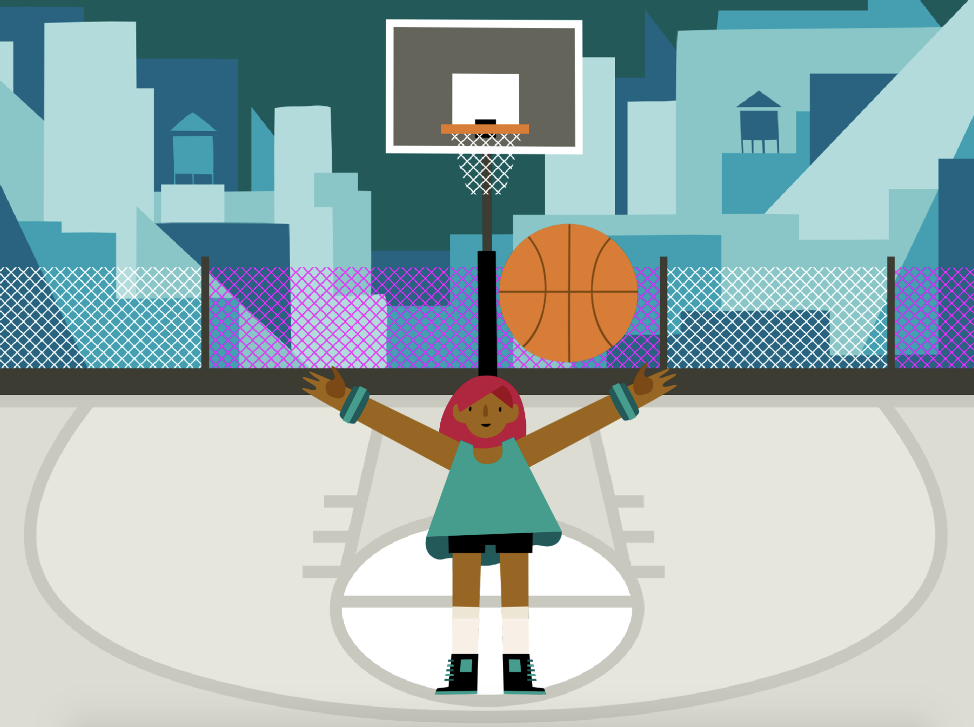
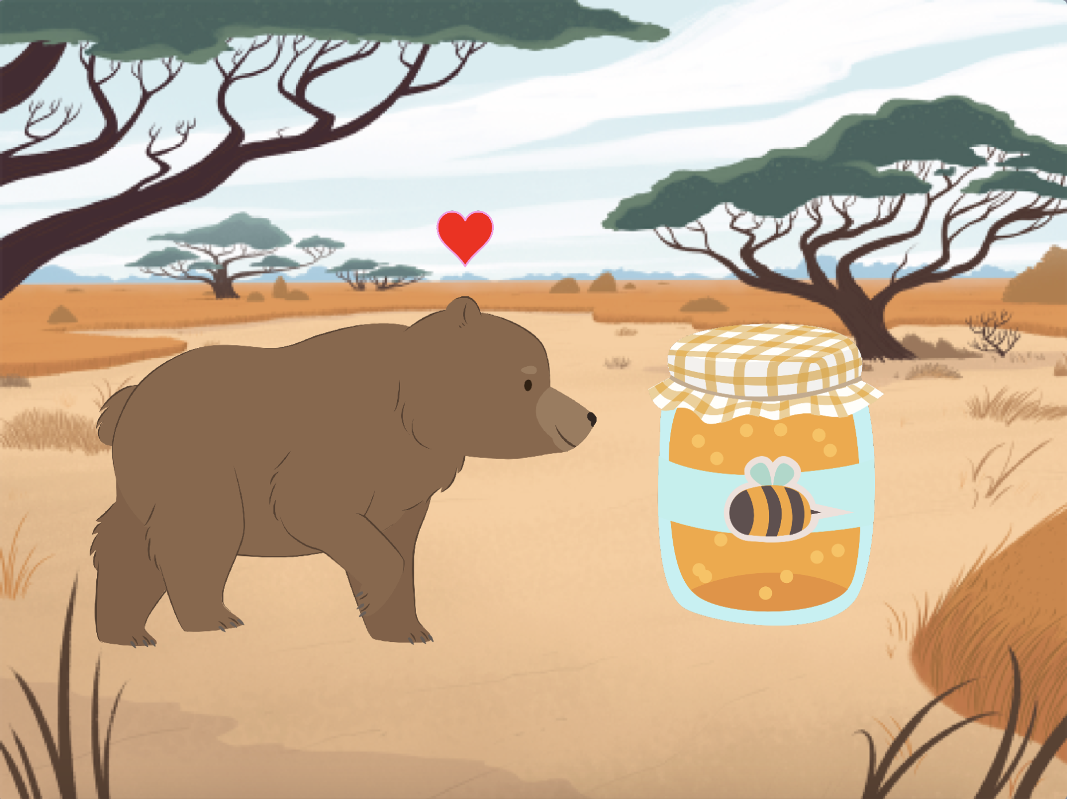

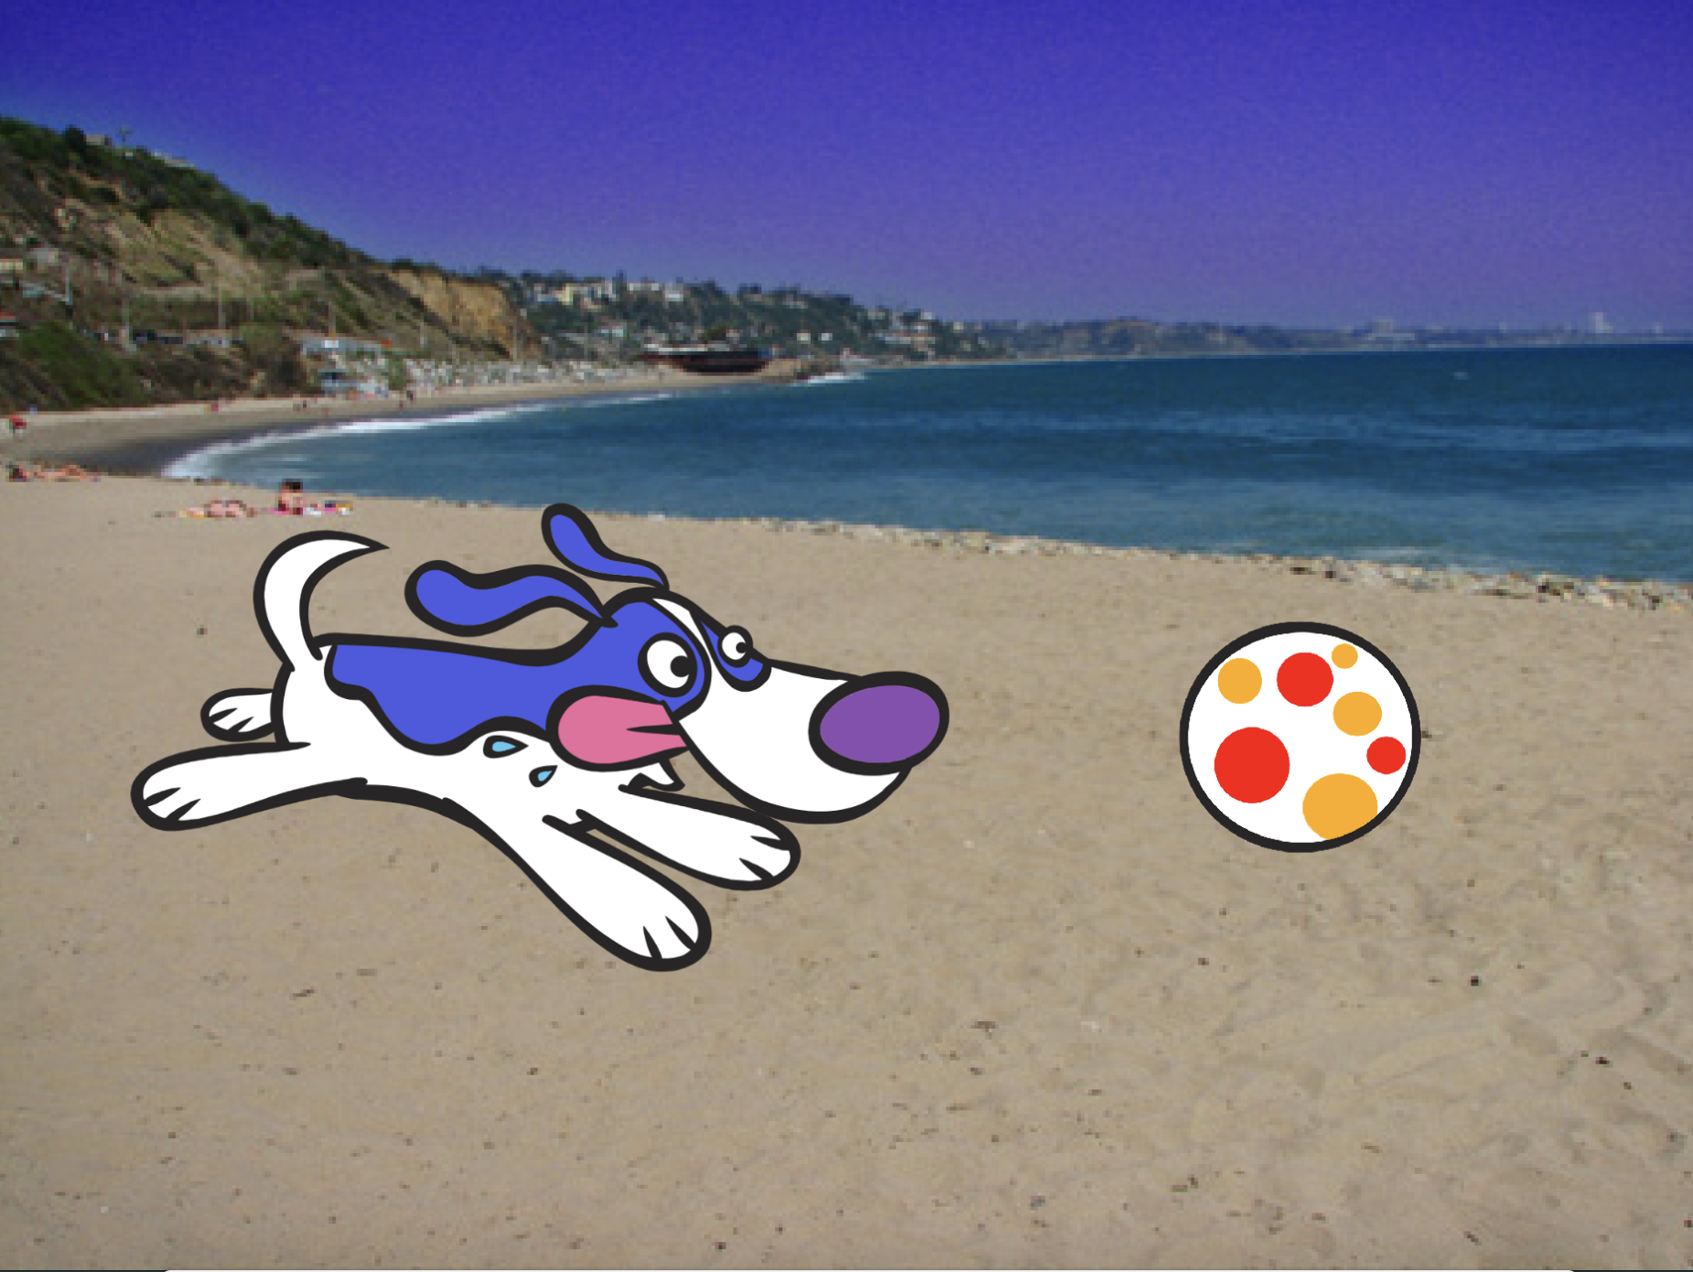
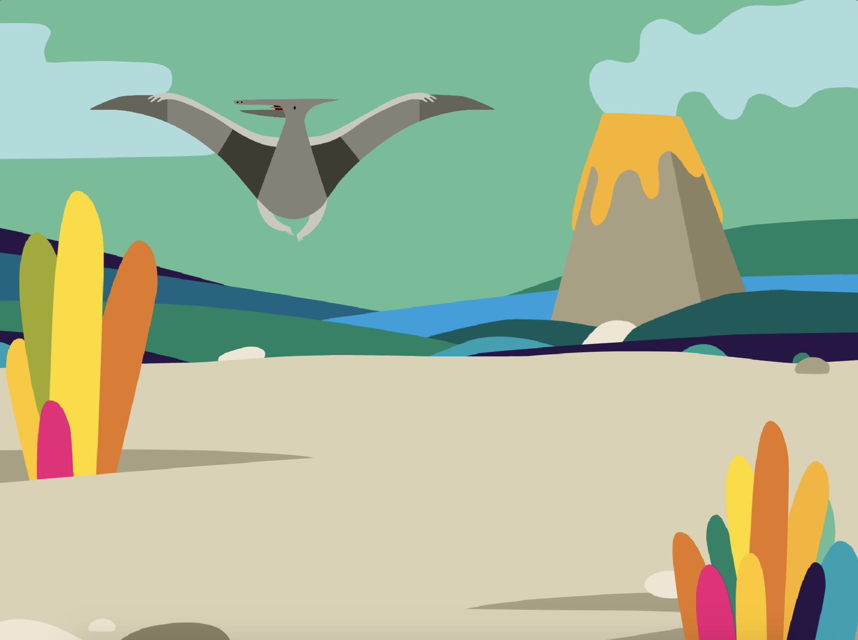
Animate a Character Cards
Bring characters to life with animation.
scratch.mit.edu
Set of 8 cards

Slide 2


Animate a Character Cards
Try these cards in any order:
Move with Arrow Keys
Make a Character Jump
Switch Poses
Glide from Point to Point
Walking Animation
Flying Animation
Talking Animation
Draw an Animation
scratch.mit.edu
Set of 8 cards

Slide 3

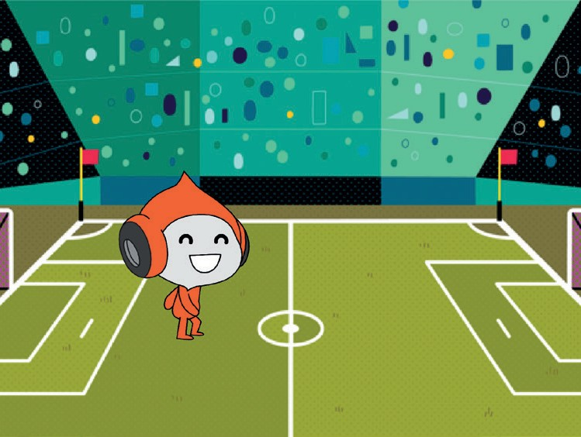

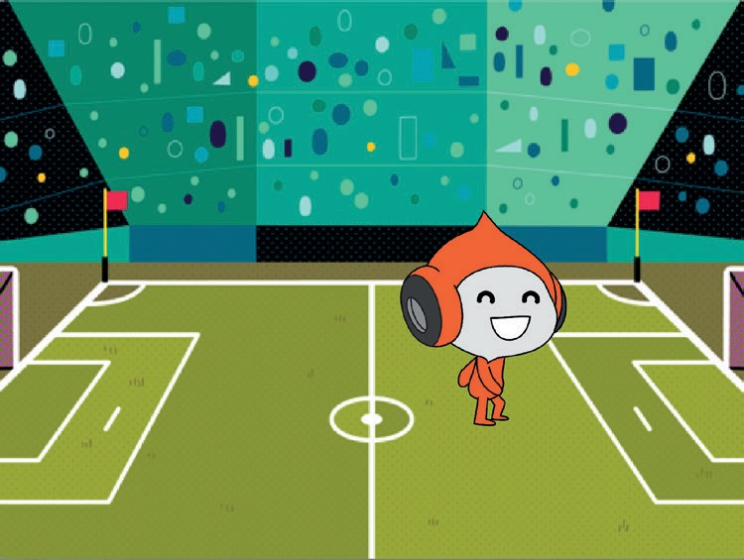


Move with Arrow Keys
Use the arrow keys to move your character around.
Animate a Character
1

Slide 4

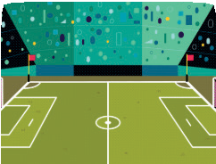


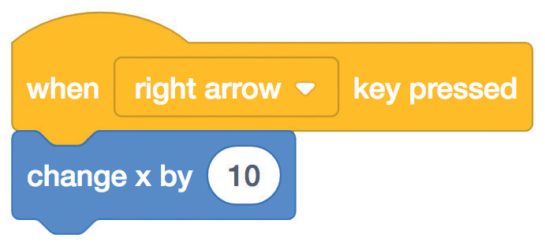
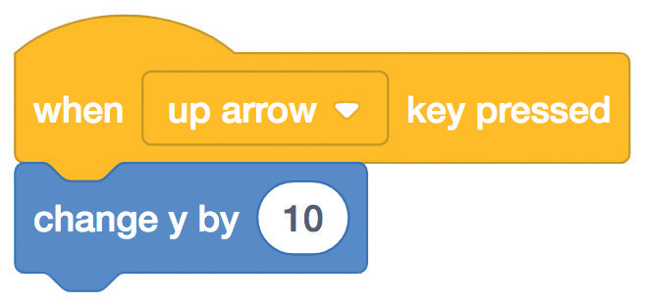
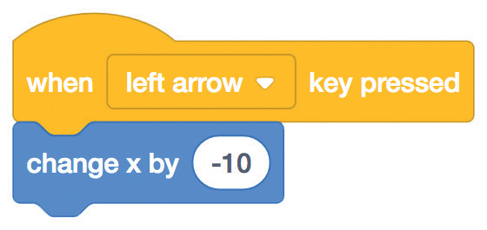
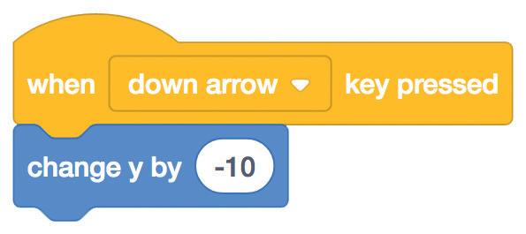



Move with Arrow Keys
scratch.mit.edu
GET READY
Choose a backdrop.
Soccer 2
Choose a character.
Pico Walking
ADD THIS CODE
Change x
Change y
Move your character side to side.
Move your character up and down.
Type a minus sign to move left.
Type a minus sign to move down.
TRY IT
Press the arrow keys on your keyboard to move your character around.

Slide 5
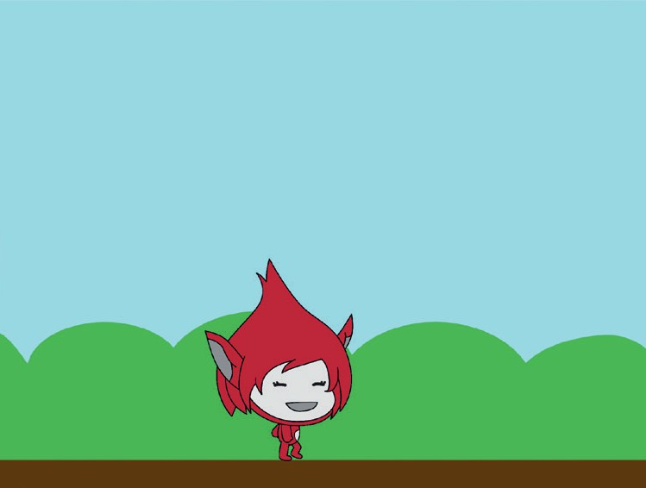
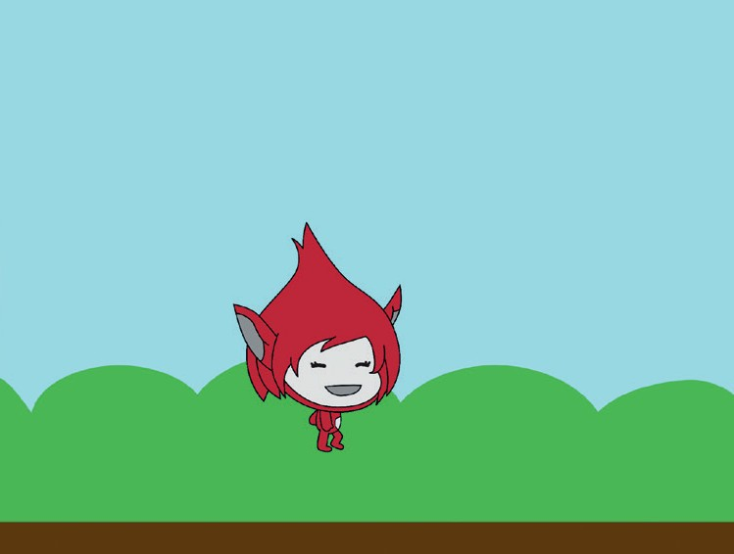
Make a Character Jump
Press a key to jump up and down.
Animate a Character
2

Slide 6

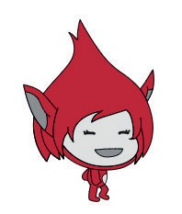
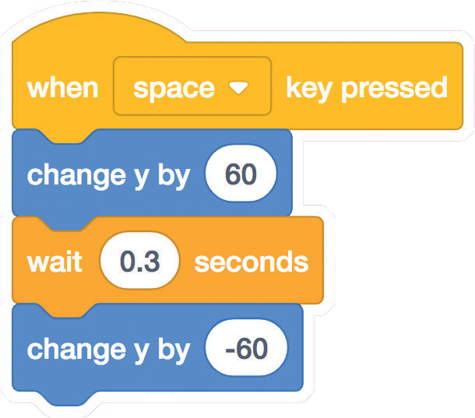

Make a Character Jump
scratch.mit.edu
GET READY
Choose a backdrop.
Blue Sky
Choose a character.
Giga Walking
ADD THIS CODE
Giga
Type how high to jump.
Type a minus sign to go back down.
TRY IT
Press the space key on your keyboard.

Slide 7
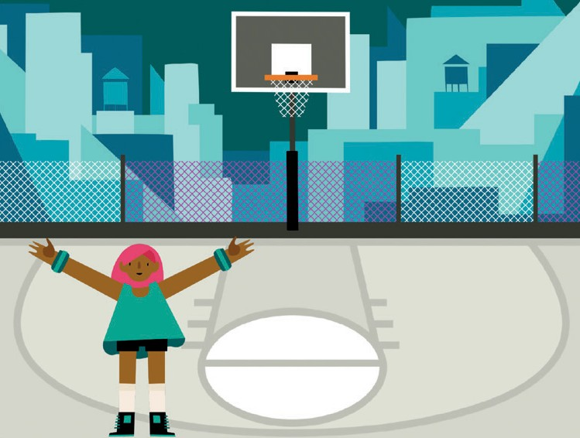
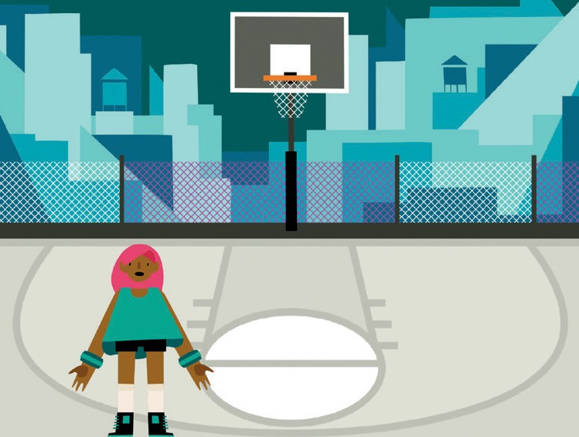
Switch Poses
Animate a character when you press a key.
Animate a Character
3

Slide 8

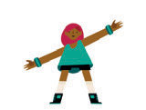
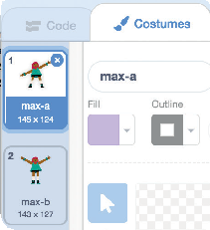

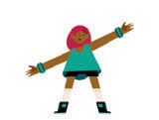
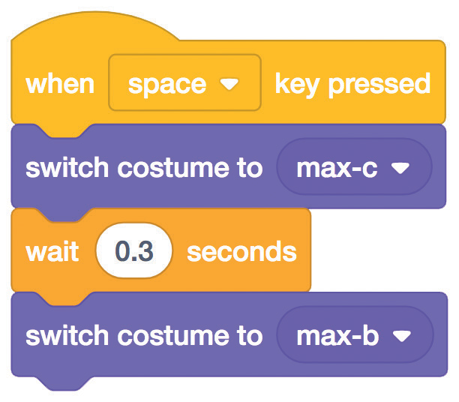
Switch Poses scratch.mit.edu
GET READY
Choose a character with multiple costumes, like Max.
Click the Costumes tab to view all of your sprite’s costumes.
Max
Scroll over sprites in the Sprite Library to see if they have different costumes.
ADD THIS CODE
Click the Code tab.
Max
Choose a costume.
Choose a different costume.
TRY IT
Press the space key on your keyboard.

Slide 9
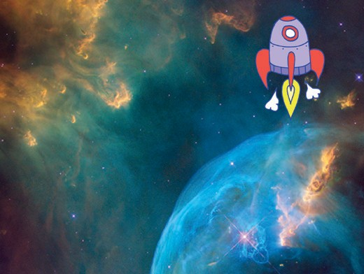
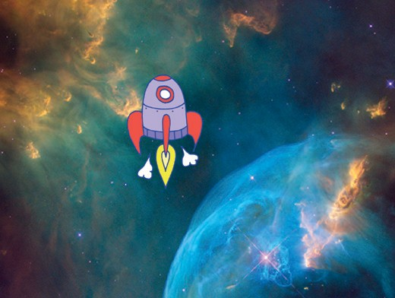
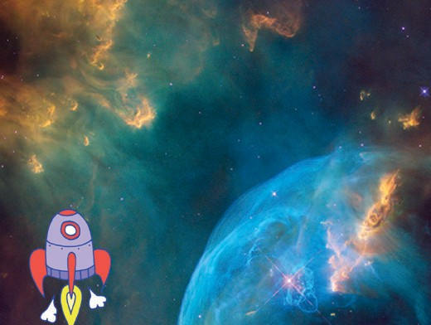
Glide from Point to Point
Make a sprite glide from point to point.
Animate a Character
4

Slide 10

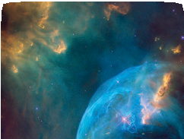


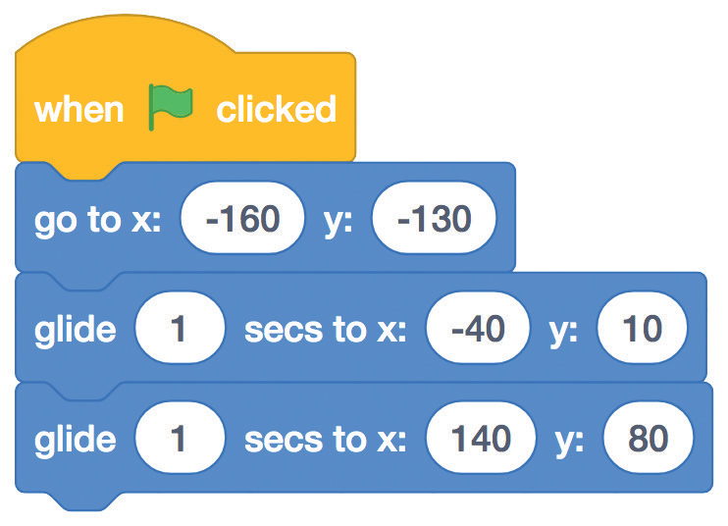


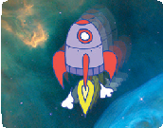
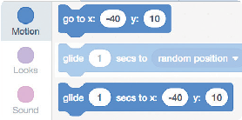
Glide from Point to Point
scratch.mit.edu
GET READY
Choose a backdrop.
Nebula
Choose a character.
Rocketship
ADD THIS CODE
Set the starting point.
Rocketship
Set another point to glide to.
Set the end point.
TRY IT
Click the green flag to start.
TIP
When you drag a sprite, its
x and y positions will update in the blocks palette.

Slide 11
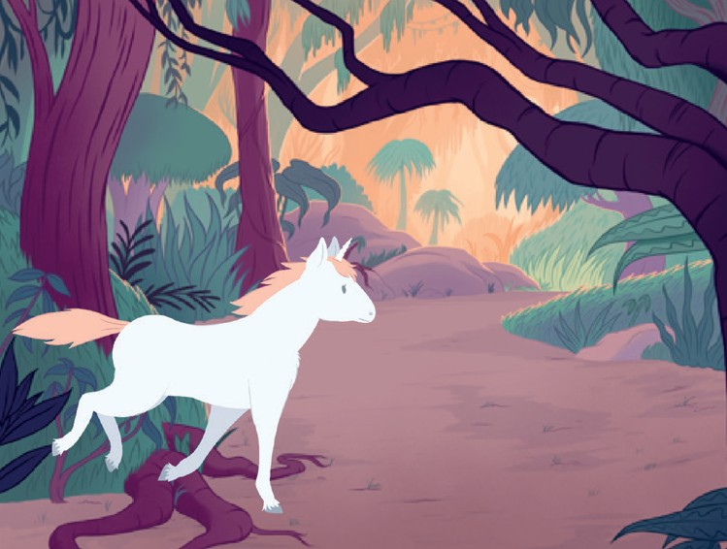
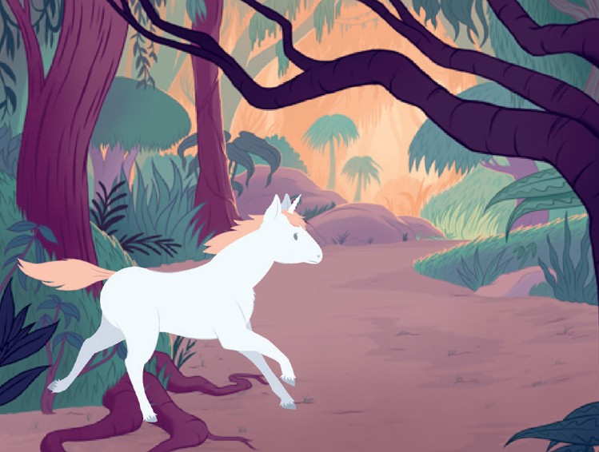
Walking Animation
Make a character walk or run.
Animate a Character
5

Slide 12

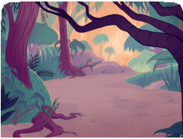

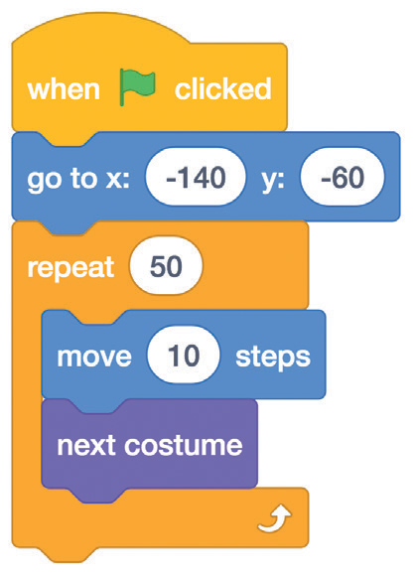

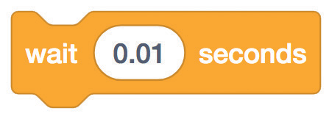
Walking Animation
scratch.mit.edu
GET READY
Choose a backdrop.
Jungle
Choose a walking or running sprite.
Unicorn Running
ADD THIS CODE
Unicorn Running
TRY IT
TIP
Click the green flag to start.
If you want to slow down the animation, try adding a wait block inside the repeat block.

Slide 13
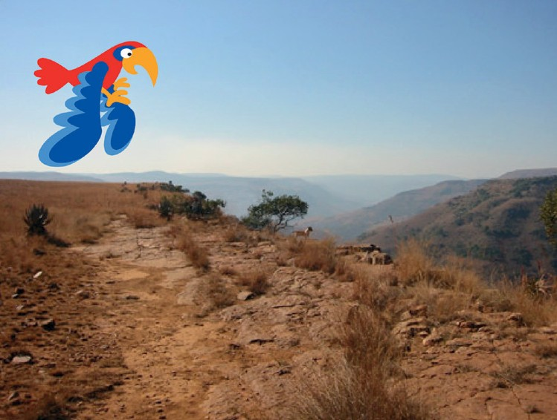
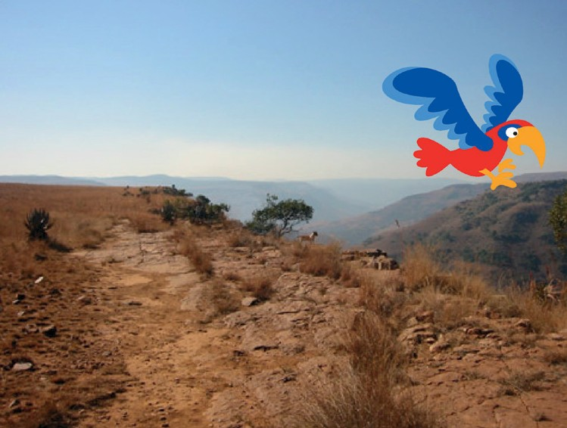
Flying Animation
Have a character flap its wings as it moves across the stage.
Animate a Character
6

Slide 14
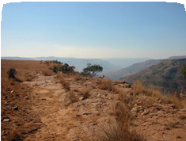

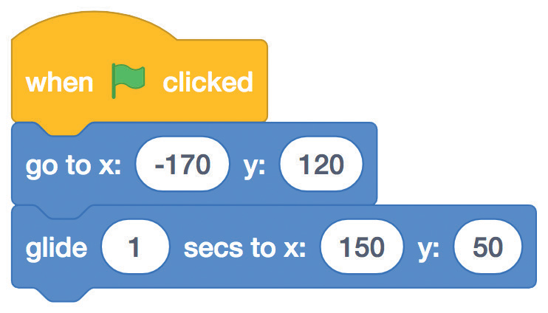
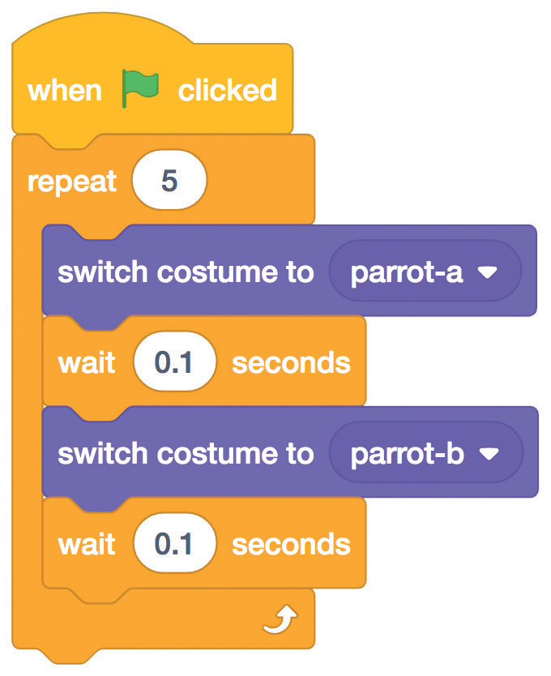

Flying Animation
scratch.mit.edu
GET READY
Choose a backdrop.
Canyon
Choose Parrot
(or another flying sprite).
Parrot
ADD THIS CODE
Glide across the screen
Flap the wings
Set the starting point.
Choose one costume.
Set the end point.
Choose another.
TRY IT
Click the green flag to start.

Slide 15
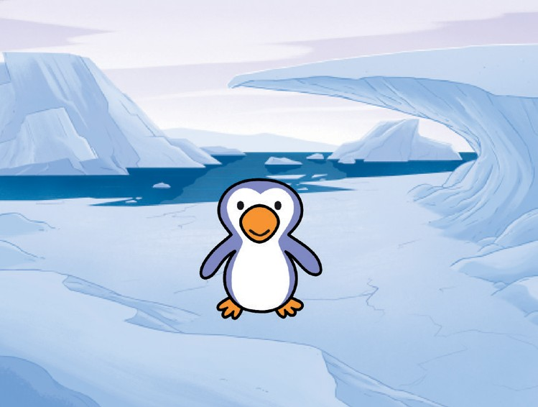
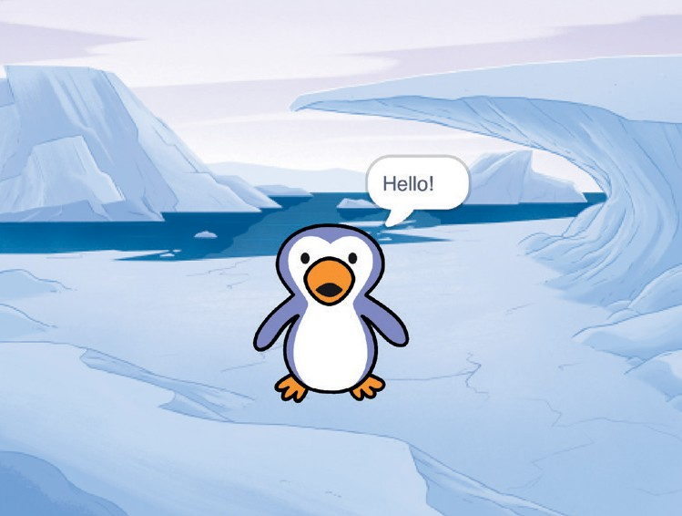
Talking Animation
Make a character talk.
Animate a Character
7

Slide 16
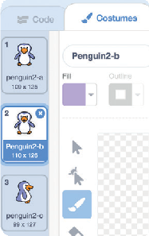



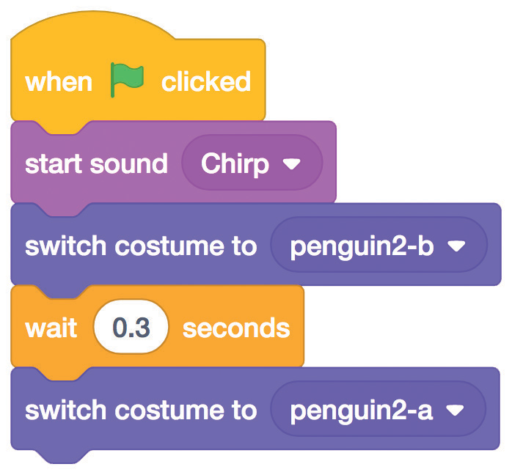
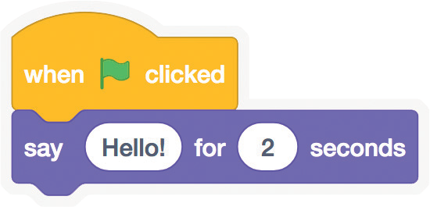
Talking Animation
scratch.mit.edu
GET READY
Click the Costumes tab to view the penguin’s other costumes.
Choose Penguin 2.
Penguin
ADD THIS CODE
Click the Code tab.
Choose one costume.
Choose another.
Type what you want your character to say.
TRY IT
Click the green flag to start.

Slide 17


Draw an Animation
Edit a sprite’s costumes to create your own animation.
Animate a Character
8

Slide 18

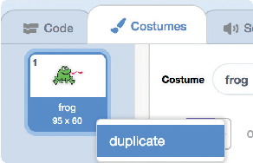
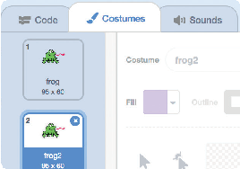


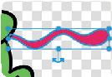
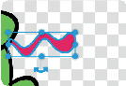


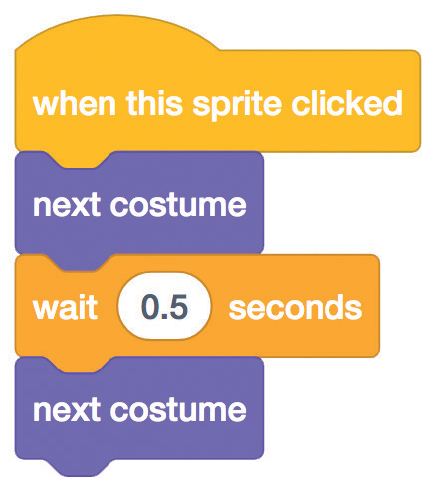

Draw an Animation
scratch.mit.edu
GET READY
Now you should have two identical costumes.
Click the Costumes tab.
Choose a character.
Frog
Right-click (on a Mac, control-click) a costume to duplicate it.
Click a costume to select and edit it.
Click the
Select tool.
Select a part of the costume to squeeze or stretch it.
Drag the handle to rotate an object you’ve selected.
ADD THIS CODE
TRY IT
Click the Code tab.
Use the next costume block to animate your character.
Click the green flag to start.

